Slide 1
Data Modeling
Lesson 7.3

Slide 2
Class Objectives
By the end of today's class, you will be able to:
Apply data modeling techniques to database design.
Normalize data.
Identify data relationships.
Create visual representations of a database through entity relationship diagrams.

Slide 3
Data Normalization

Slide 4

Data normalization is the process of restructuring data to a set of defined "normal forms."

Slide 5
The process of data normalization eliminates data redundancy and inconsistencies.

Slide 6
Data Normalization
The process of restructuring data to a set of “normal forms.”
Reduces and eliminates data redundancy and inconsistencies
Three most common forms:
First normal form (1NF)
Second normal form (2NF)
Third normal form (3NF)
There are even more levels!

Slide 7

First Normal Form (1NF)
Each field in a table row should contain a single value.
Each row is unique.
Rows can have fields that repeat.
Whole rows do not fully match.
Raw Data
Normalization
First Normal Form
family | children
Smith | Chris, Abby, Susy
Jones | Steve, Mary, Dillion
family | children
Smith | Abby
Smith | Susy
Jones | Mary
Smith | Chris
Jones | Dillion
Jones | Mary

Slide 8
Second Normal Form (2NF)
Must be in first normal form
Single column primary key
Primary key
Identifies the table and row uniquely
Generally, there could be a need to create a new table.
Data in 1NF
2NF Normalization
Family Table
Child Table
family | children
Smith | Abby
Smith | Susy
Jones | Mary
Smith | Chris
Jones | Dillion
Jones | Mary
family_id | family
1 | Smith
2 | Jones
child_id | family_id | children
11 | 1 | Chris
22 | 1 | Abby
33 | 1 | Susy
44 | 2 | Steve
55 | 2 | Mary
66 | 2 | Dillion

Slide 9
Transitive dependency is the reliance of a column’s value on another column through a third column.

Slide 10
Transitive Dependency
Transitive | If X > Y and Y > Z, then X > Z.
Dependency | One value relies on another. Examples: city relies on postal code; age relies on birthday.
For example | Say you have three columns: StoreName, OwnerAddress, OwnerName. OwnerName and OwnerAddress rely on StoreName. OwnerAddress also depends on OwnerName. Therefore, OwnerAddress is transitively dependent on StoreName through OwnerName.

Slide 11
Third Normal Form (3NF)
Must be in second normal form
Contains non-transitively dependent columns
owner_id | owner_name | owner_address | store_name
11 | Marshall | 123, Fake Street | Soups and Stuff
22 | Susan | 44, New Drive | Sink Emporium
33 | Molly | 99, Old Lane | Tasty Burgers
3NF Normalization
owner_id | owner_name | owner_address
11 | Marshall | 123, Fake Street
22 | Susan | 44, New Drive
33 | Molly | 99, Old Lane
store_id | store_name | Owner_id (fk)
1 | Soups and Stuff | 11
2 | Sink Emporium | 22
3 | Tasty Burgers | 33

Slide 12
Activity: Employee Normalizer
In this activity, you will be organizing improperly stored employee data into the three normal forms.
(Instructions sent via Slack)
15 minutes

Slide 14
Foreign Keys

Slide 15
Foreign Keys
Foreign keys reference the primary key of another table.
Can have a different name
Do not need to be unique
Primary Key
Primary Key
Foreign Key
family_id | family
1 | Smith
2 | Jones
child_id | family_id | children
11 | 1 | Chris
22 | 1 | Abby
33 | 1 | Susy
44 | 2 | Steve
55 | 2 | Mary
66 | 2 | Dillion

Slide 16
Activity: Foreign Keys
In this activity, you will create tables with foreign keys.
(Instructions sent via Slack)
15 minutes

Slide 18
Data Relationships

Slide 19
Data Relationships
One-to-One
One-to-Many
Many-to-Many

Slide 20
One-to-One Relationship
ID | Name | Social Security
1 | Homer | 111111111
2 | Marge | 222222222
3 | Lisa | 333333333
4 | Bart | 444444444
5 | Maggie | 555555555
Each item in one column is linked to only one other item from the other column.
Here, each person in the Simpson family can have only one Social Security number.
Each Social Security number can be assigned to only one person.

Slide 21
One-to-Many Relationship
ID | Address |  | ID | Name | Social Security | AddressID
11 | 742 Evergreen Terrace |  | 1 | Homer | 111111111 | 11
12 | 221B Baker Street |  | 2 | Marge | 222222222 | 11
 |  |  | 3 | Lisa | 333333333 | 11
 |  |  | 4 | Bart | 444444444 | 11
 |  |  | 5 | Maggie | 555555555 | 11
 |  |  | 6 | Sherlock | 112233445 | 12
 |  |  | 7 | Watson | 223344556 | 12
Two tables: one for people, another for addresses.
Each person has only one address.
But each address can be associated with multiple people.

Slide 22
One-to-Many Relationship
ID | Address |  | ID | Name | Social Security | AddressID
11 | 742 Evergreen Terrace |  | 1 | Homer | 111111111 | 11
12 | 221B Baker Street |  | 2 | Marge | 222222222 | 11
 |  |  | 3 | Lisa | 333333333 | 11
 |  |  | 4 | Bart | 444444444 | 11
 |  |  | 5 | Maggie | 555555555 | 11
 |  |  | 6 | Sherlock | 112233445 | 12
 |  |  | 7 | Watson | 223344556 | 12
The two tables, joined, would look like this.
Each person has an address.
Each address can be associated with multiple people.

Slide 23
Many-to-Many Relationship
ID | Child |  | ID | Parent
1 | Bart |  | 11 | Homer
2 | Lisa |  | 12 | Marge
3 | Maggie
Each child can have more than one parent.
Each parent can have more than one child.

Slide 24
Many-to-Many Relationship
ChildID | Child | ParentID | Parent
1 | Bart | 11 | Homer
1 | Bart | 12 | Marge
2 | Lisa | 11 | Homer
2 | Lisa | 12 | Marge
3 | Maggie | 11 | Homer
3 | Maggie | 12 | Marge
Each child can have more than one parent.
Each parent can have more than one child.
The two tables are joined in a junction table.

Slide 25
Junction Table
parent
parent_id |  | INTEGER
parent_name |  | VARCHAR
...
 | parent_id integer | child_id integer
1 | 11 | 1
2 | 11 | 2
3 | 11 | 3
4 | 12 | 1
5 | 12 | 2
6 | 12 | 3
child_parent_junction
parent_id |  | INTEGER
child_id |  | INTEGER
Join child and parent table to junction table
child
child_id |  | INTEGER
child_name |  | VARCHAR
...
 | parent_name character varying (255) | child_name character varying (255)
1 | Homer | Bart
2 | Homer | Lisa
3 | Homer | Maggie
4 | Marge | Bart
5 | Marge | Lisa
6 | Marge | Maggie
The junction table contains many parent_ids and many child_ids.

Slide 26
Activity: Data Relationships
In this activity, students will create table schemata for agents and regions, and then create a junction table to display all regions assigned to agents.
(Instructions sent via Slack)
15 minutes

Slide 29
Connecting Pandas with PostgreSQL

Slide 30
Activity: Feeding Pandas with SQL
In this activity, students will read data into a Pandas DataFrame from a PostgreSQL database using SQLAlchemy.
(Instructions sent via Slack)
15 minutes

Slide 32
Entity Relationship Diagrams

Slide 33
An entity relationship diagram, or ERD, is a visual representation of entity relationships within a database.

Slide 34
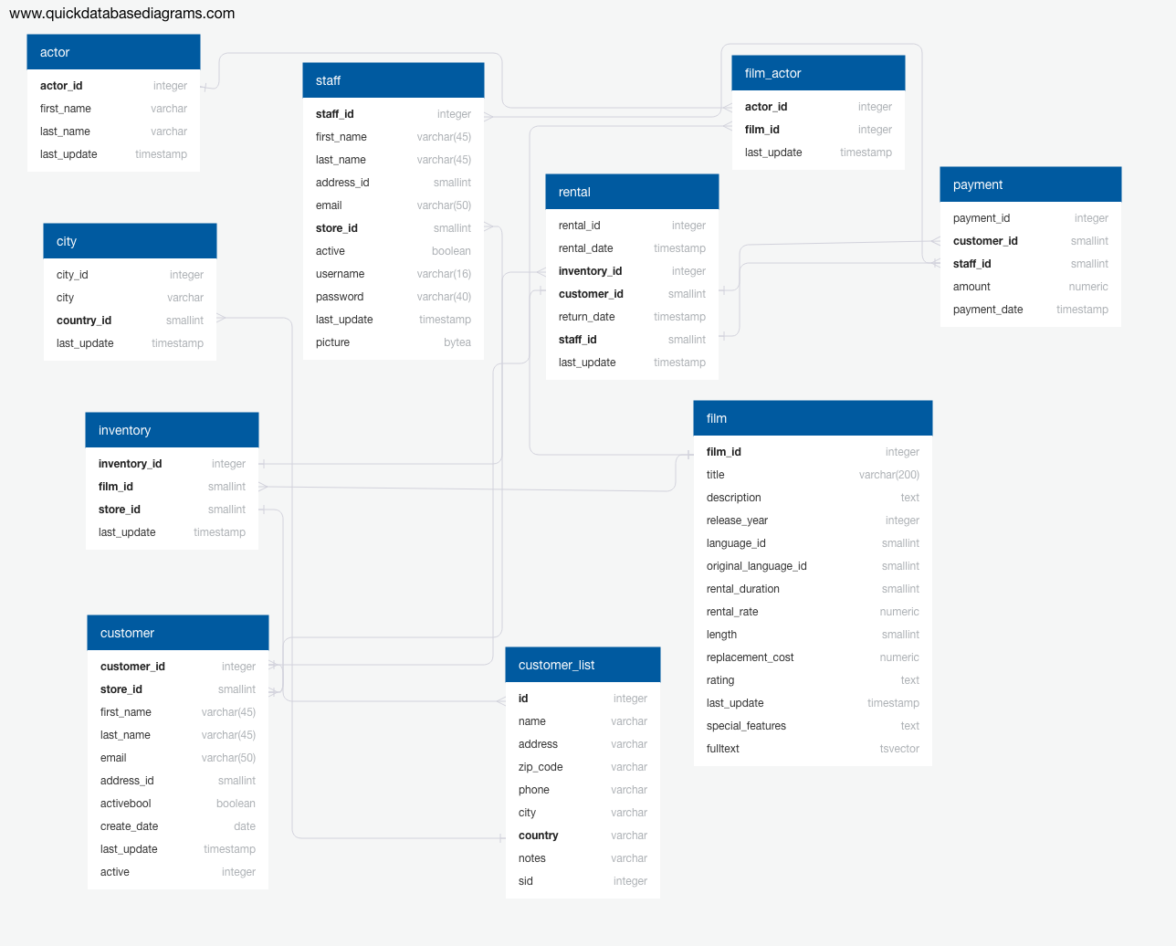
ERDs
Entities, their data types, and relationships are all illustrated in the diagram.

Slide 35
ERDs
There are three types of ERDs, or data models, used when creating diagrams:
Conceptual | Basic information containing table and column names.
Logical | Slightly more complex than conceptual models with primary & foreign keys defined.
Physical | Blueprint of the database, reflecting relationships, attributes and data types.

Slide 36
Activity: Designing an ERD, Part 1
In this activity, you will work with a partner to create a mortgage lending database model.
(Instructions sent via Slack)
15 Minutes

Slide 38
Activity: Designing an ERD, Part 2
In this activity, you and your partner will continue designing a database model for the mortgage lending database by transitioning your logical ERD created in the previous activity to a physical ERD.
(Instructions sent via Slack)
15 minutes

Slide 40
Structured Review

Slide 41

QUESTIONS

